Slide 1



Line follower robot with collision avoidance

Slide 2
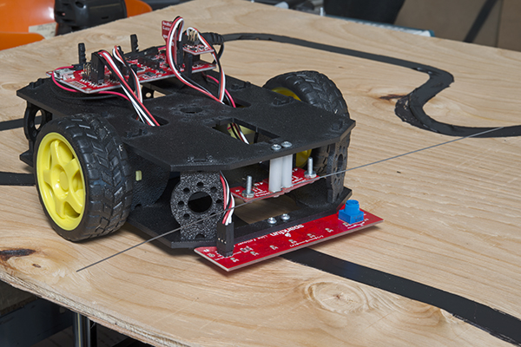
principle
self-operating robot that detects and follows a line drawn on the floor.
path to be taken is indicated by a white line on a black surface.

Slide 3
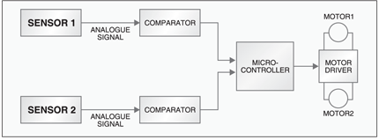
Block diagram
SENSOR 3

Slide 4
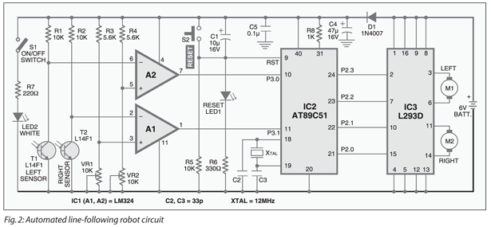
CIRCUIT DIAGRAM
P3.1
P3.2
IR SENSOR

Slide 5
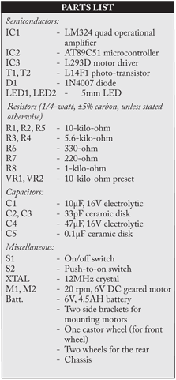
PARTS
3 IR SENSORS
IC AT89C51(MICROCONTROLLER)
IC L293 (MOTOR DRIVER)
2 DC MOTORS
FRONT BALL WHEEL
2 REAR CIRCULAR WHEELS
CAPACITORS,RESISTORS
CRYSTAL OSCILLATOR
PUSH BUTTON (RST)

Slide 6
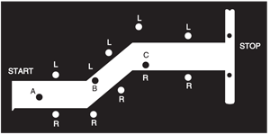
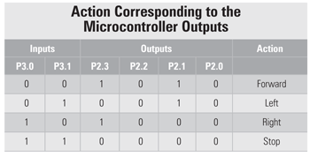
Case 0:
P3.2 high
Action - stop
Case 1:
Case 2:
Case 3:
Case 4:

Slide 7
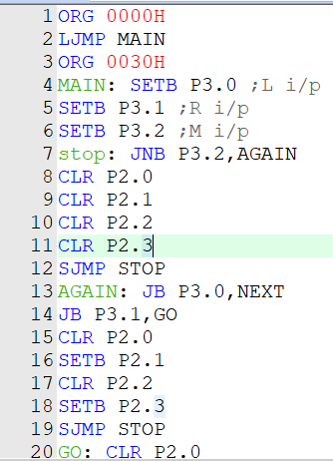
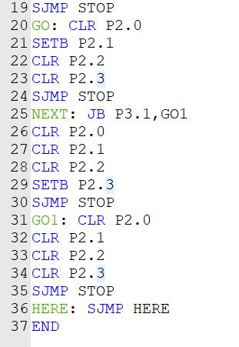
code

Slide 8
Simulation results
Done using keil microvision

Slide 9
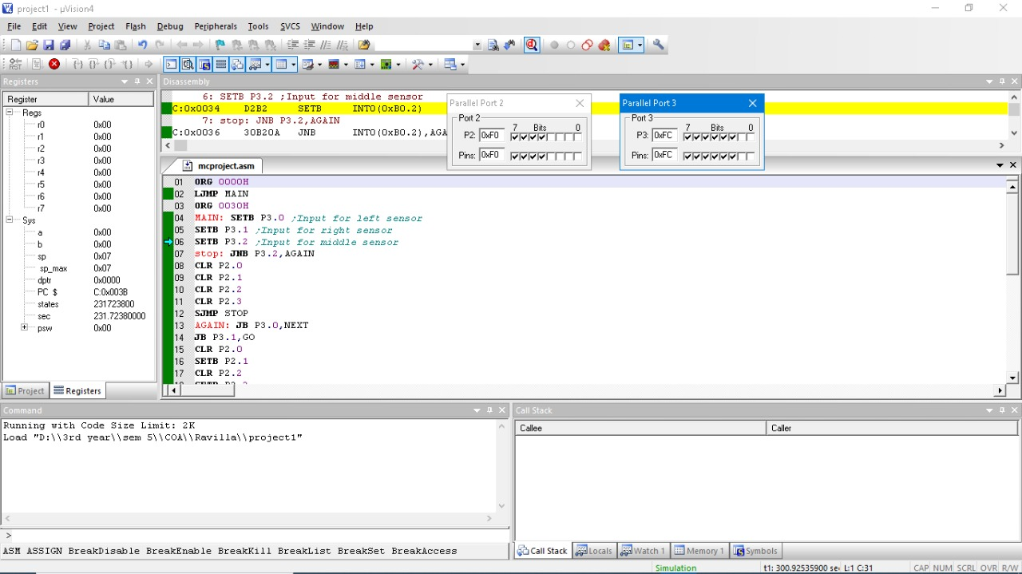
Case 0

Slide 10
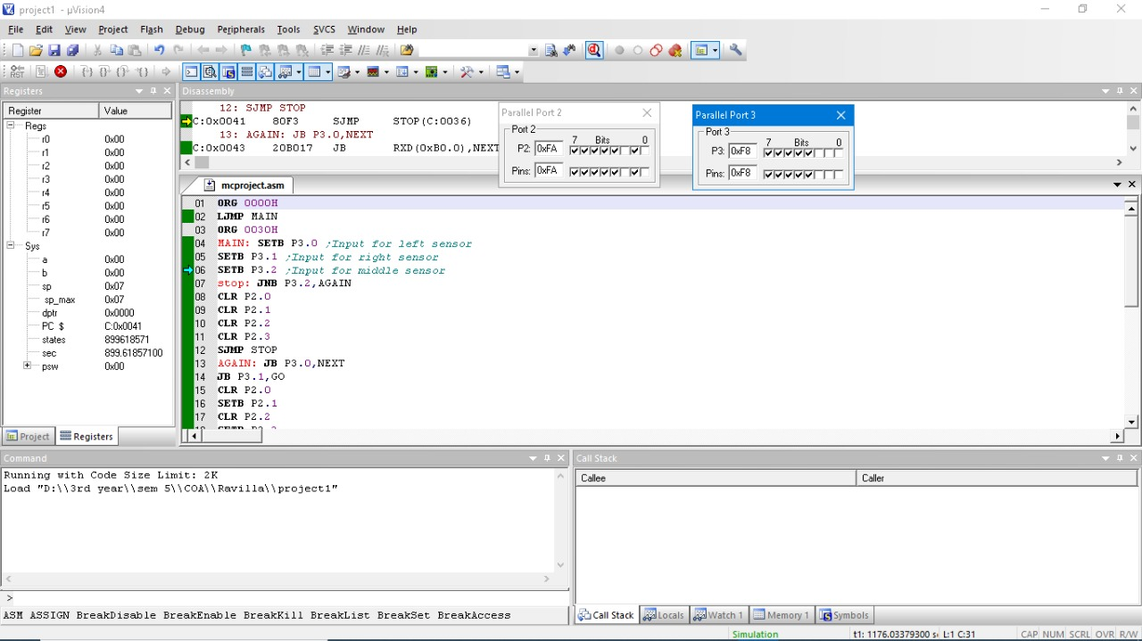
Case 1

Slide 11
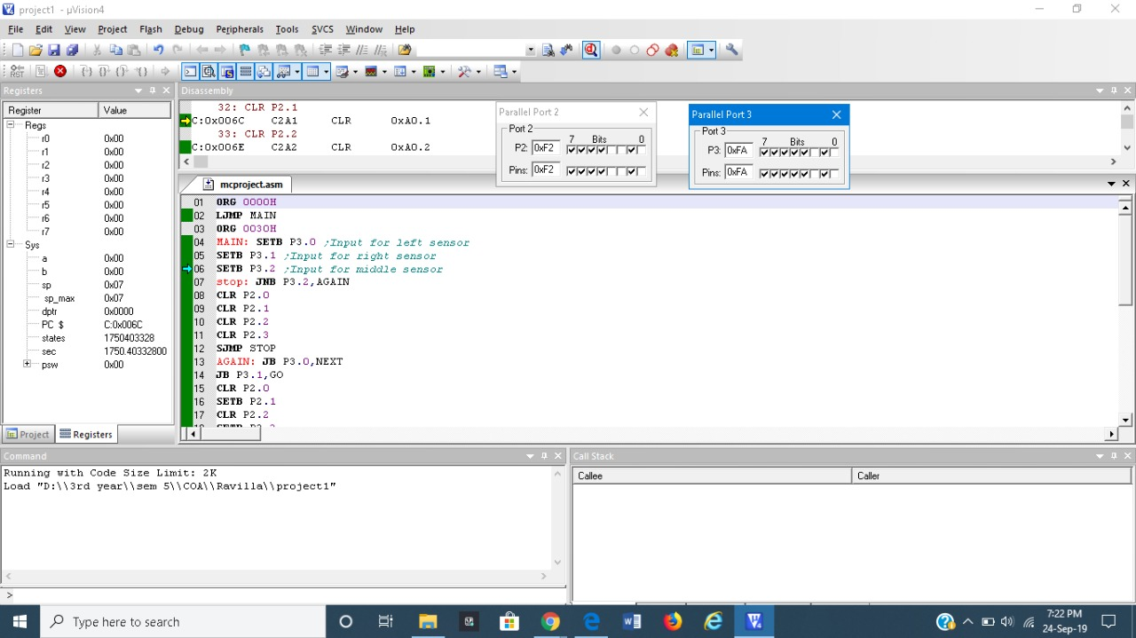
Case 2

Slide 12
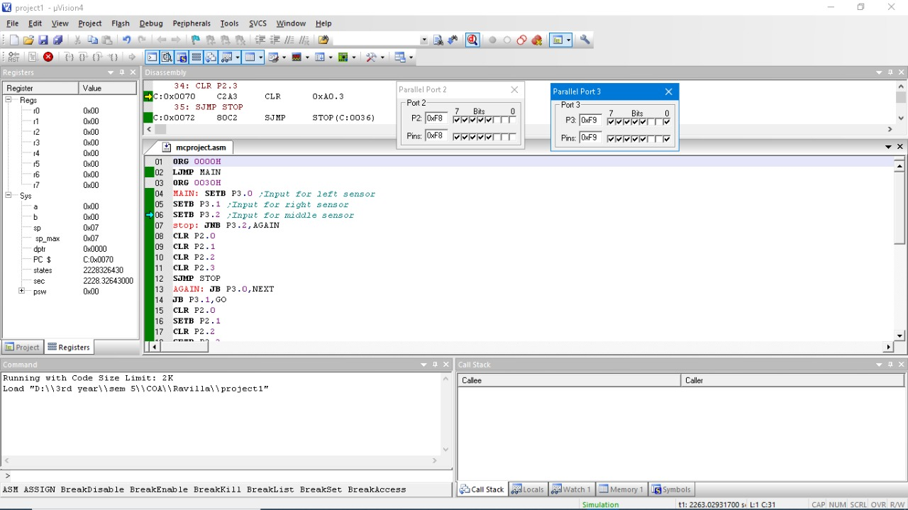
Case 3

Slide 13

Case 4

Slide 14
application
A line follower robot with pick-and-placement capabilities is commonly used in manufacturing plants.

